Slide 1

BrickStore
Group Members :
1.Abhidatt Sharma (250245920001)
2.Akanksha Mankar (250245920007)
3.Shraddha Puslekar (250245920082)
4.Manish Jaiswal (250245920049)
1

Slide 2

BrickStore
This presentation outlines the architecture and features of a new full-stack portal. It connects users, employees, and administrators efficiently. We will explore its core functionalities and technical stack.
2.

Slide 3
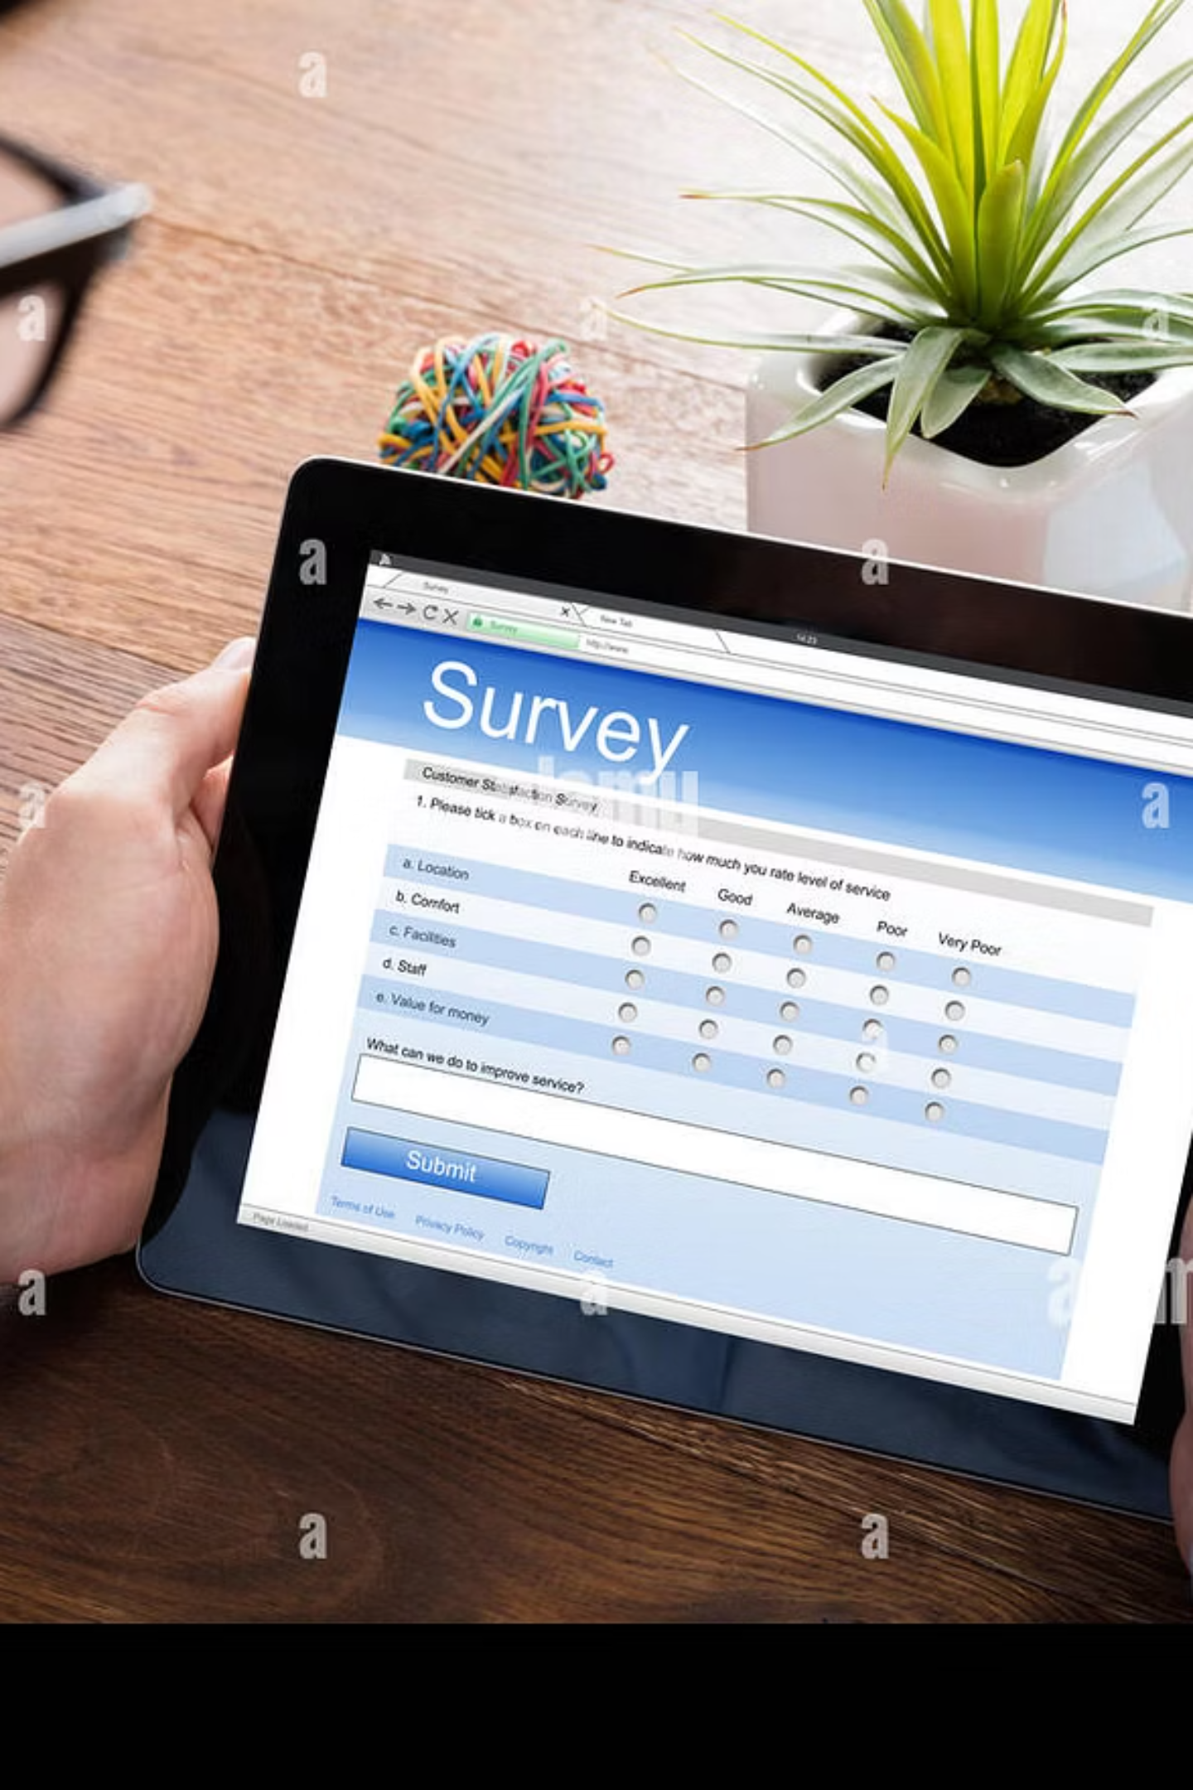



User Workflow: From Inquiry to Site Visit
Login and Form Submission
Users authenticate and provide project details.
Appointment Booking
Schedule a site visit for measurement and feasibility.
Pending Site Visit
Status updates after successful appointment booking.
3.

Slide 4

Employee Workflow: Verification and Order Unlock
Assigned Appointments
Employees view their scheduled site visits.
Site Measurement & Confirmation
Input verified plot size and add notes.
Enable Place Order
Confirmation enables the order button for the user.
4.

Slide 5
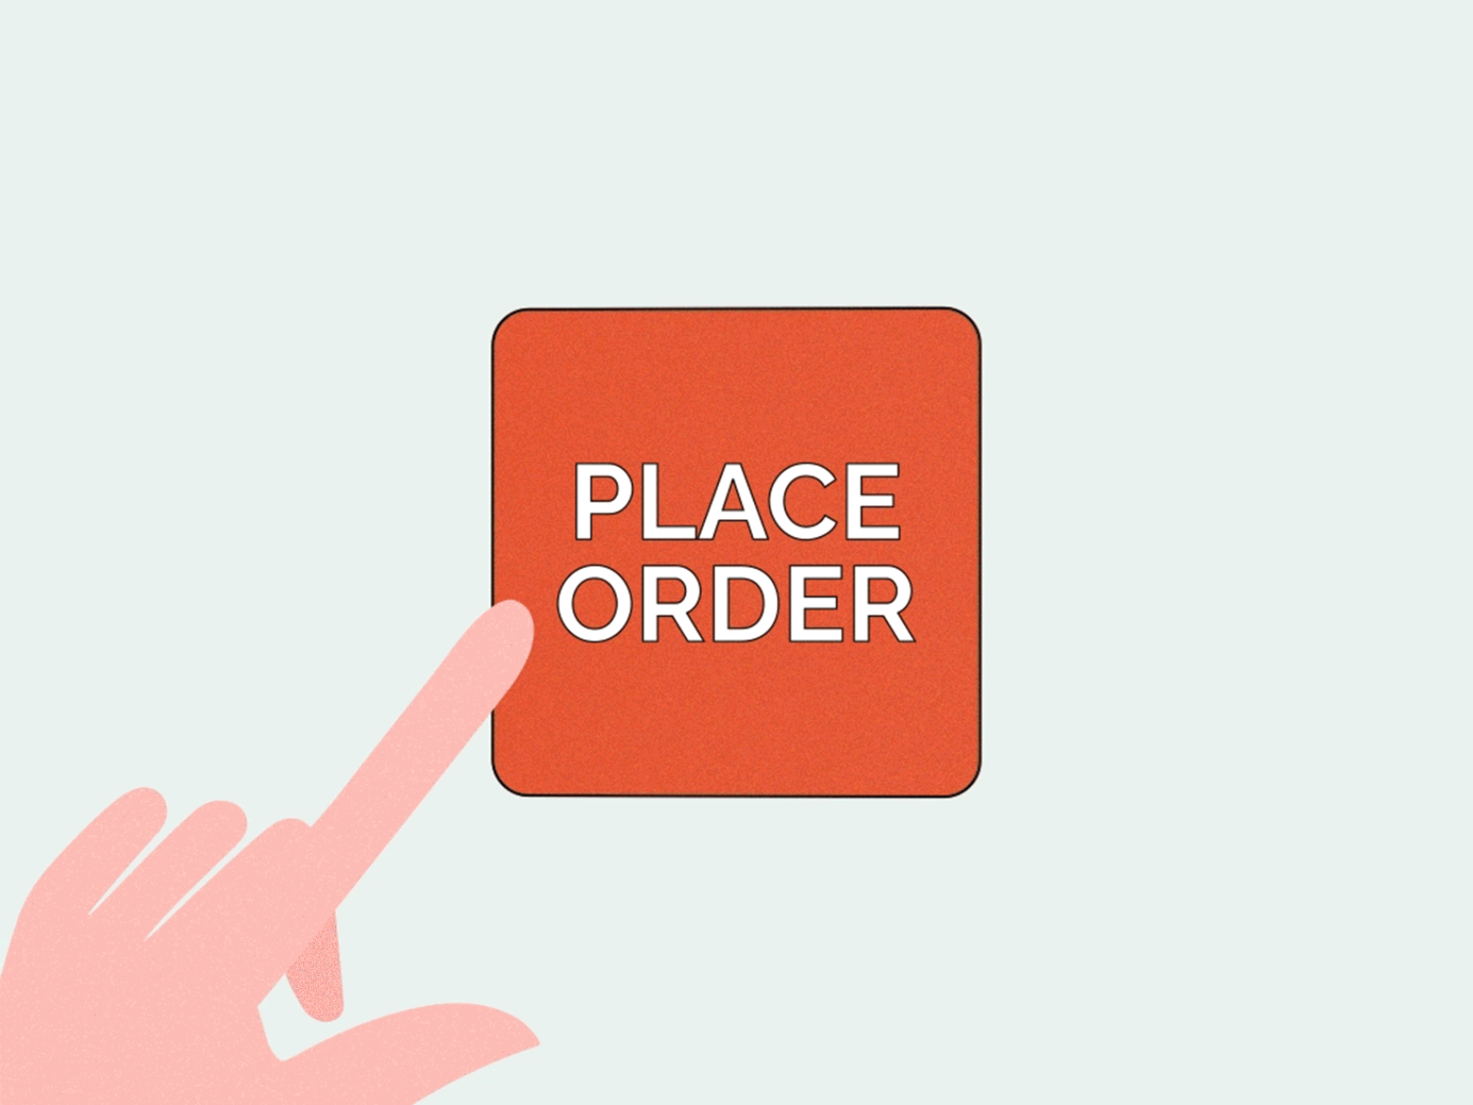
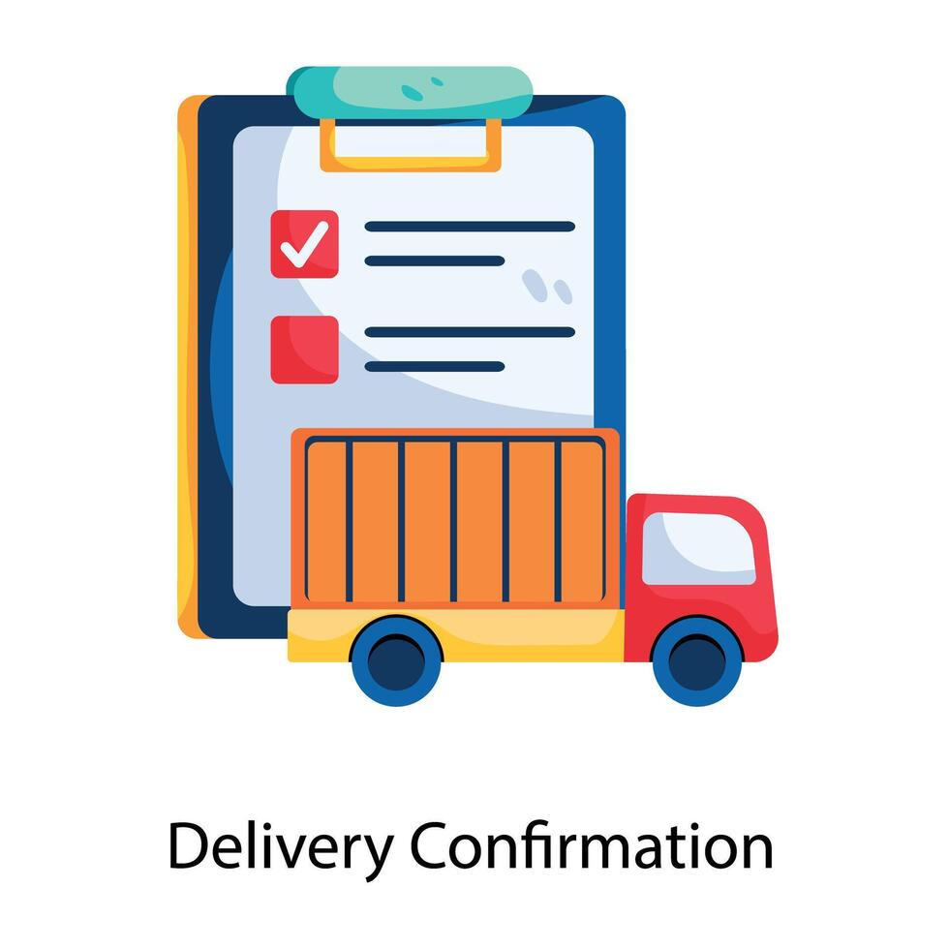
Order Placement and Delivery Confirmation
Order Placement
Delivery Confirmation
Once the site is verified, the user can proceed to place the order. The order details are then routed to the administrator for processing and vendor assignment.
After vendor material dispatch, an employee verifies receipt. The system then updates the delivery status to "Delivered," confirming completion.
5.

Slide 6





Core Features: Role-Based Access and UIs
Authentication
Secure role-based login for all users.
User UI
Submit details, book appointments, place orders.
Employee UI
Manage visits, input measurements, confirm deliveries.
Admin UI
Oversee users, assign vendors, manage operations.
6.

Slide 7
Database Design: MySQL Schema
The system utilizes a MySQL database. It structures and manages all portal data. Key tables support the various workflows.
Users
Store user profiles and roles.
Appointments
Track site visit bookings.
Site Verifications
Record employee site confirmations.
Orders
Manage all placed construction orders.
Vendors
Maintain vendor information.
Deliveries
Track material delivery status.
Items list
cement, bricks, plumbing, electrical, etc.
7.

Slide 8

Frontend Development: React.js
React.js powers the interactive and dynamic user interface. It provides efficient component-based architecture for diverse user roles.
Component-Based UI
Routing
Conditional Rendering
Modular and reusable UI elements for scalability.
Seamless navigation between different portal sections.
Dynamic content display based on user roles.
8.

Slide 9
Backend Development: .NET Web API
.NET Web API forms the robust backend. It handles all business logic. MS.NET provides a powerful framework for developing secure and scalable APIs.
RESTful APIs
Authentication & Authorization
Enable seamless communication between frontend and database.
Secure user access based on roles and permissions.
CRUD Operations
Scalability & Performance
Full support for creating, reading, updating, deleting data.
Optimized for high-volume transactions.
9.

Slide 10






Enhanced Features and Next Steps
To further improve user experience and operational efficiency, we propose additional features. These enhancements will provide deeper insights and streamlined communication.
Analytics Dashboard
Visual representation of portal metrics.
Notifications
Email/SMS alerts for key status updates.
Future Integrations
Expand with external services (e.g., payment gateways).
10.

Slide 11
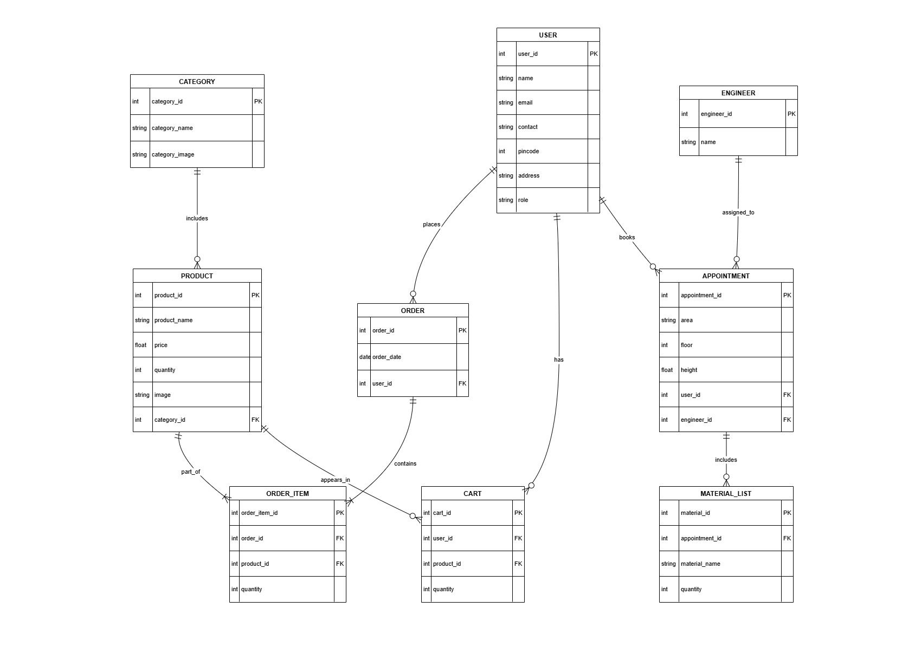
Entity-Relationship Diagram (ERD)
11.

Slide 12
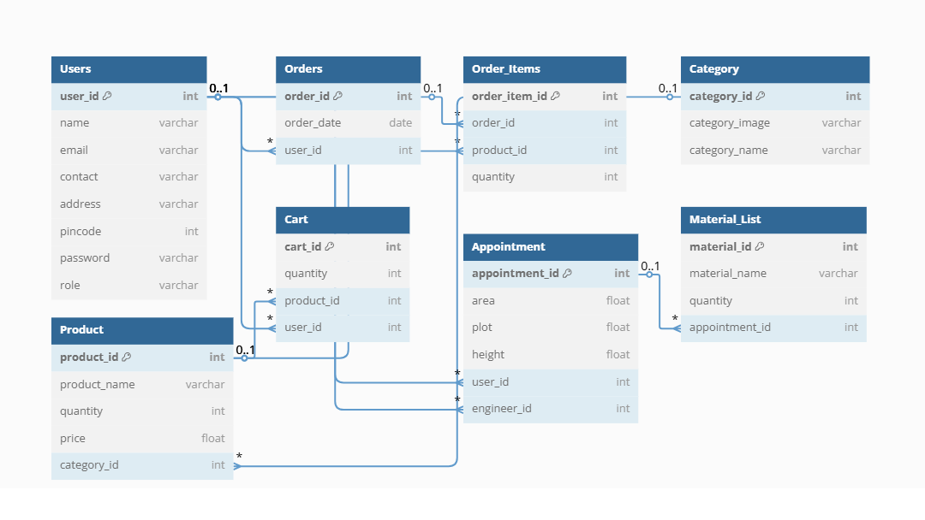
Class Diagram
12.

Slide 13
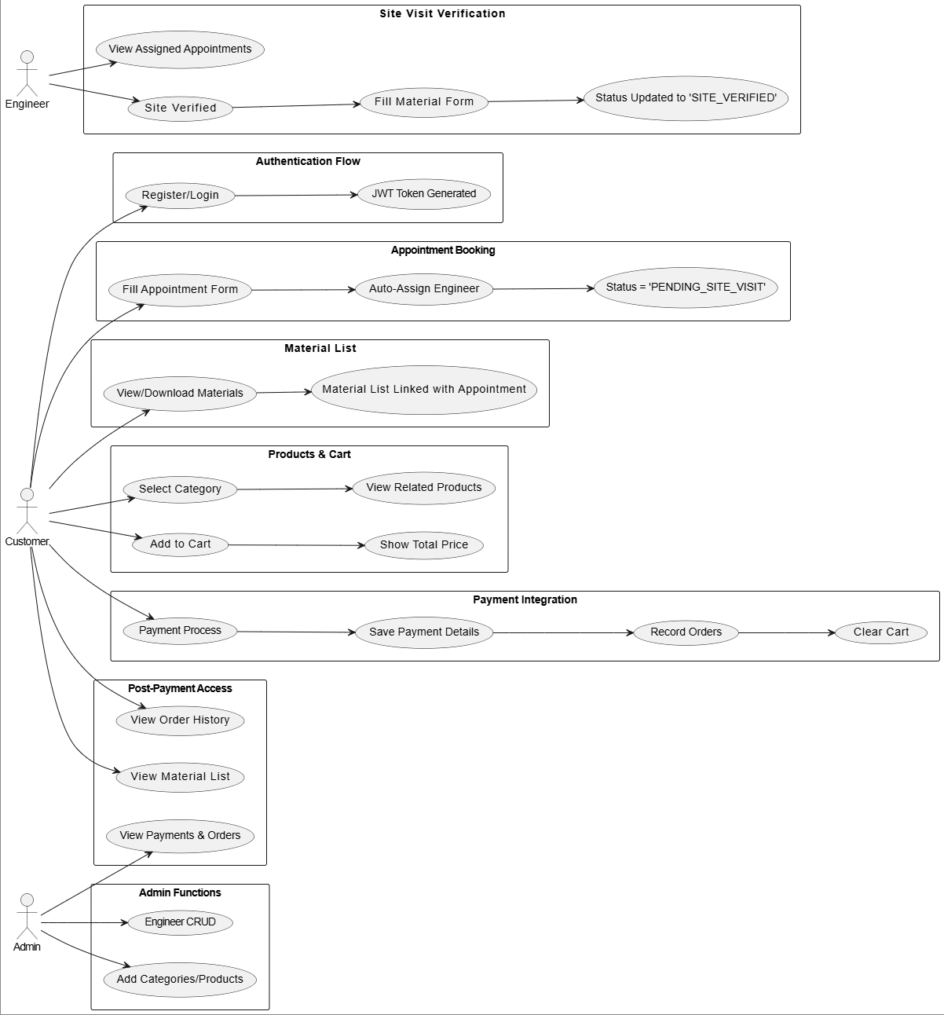
Use Case Diagram
13.

Slide 14
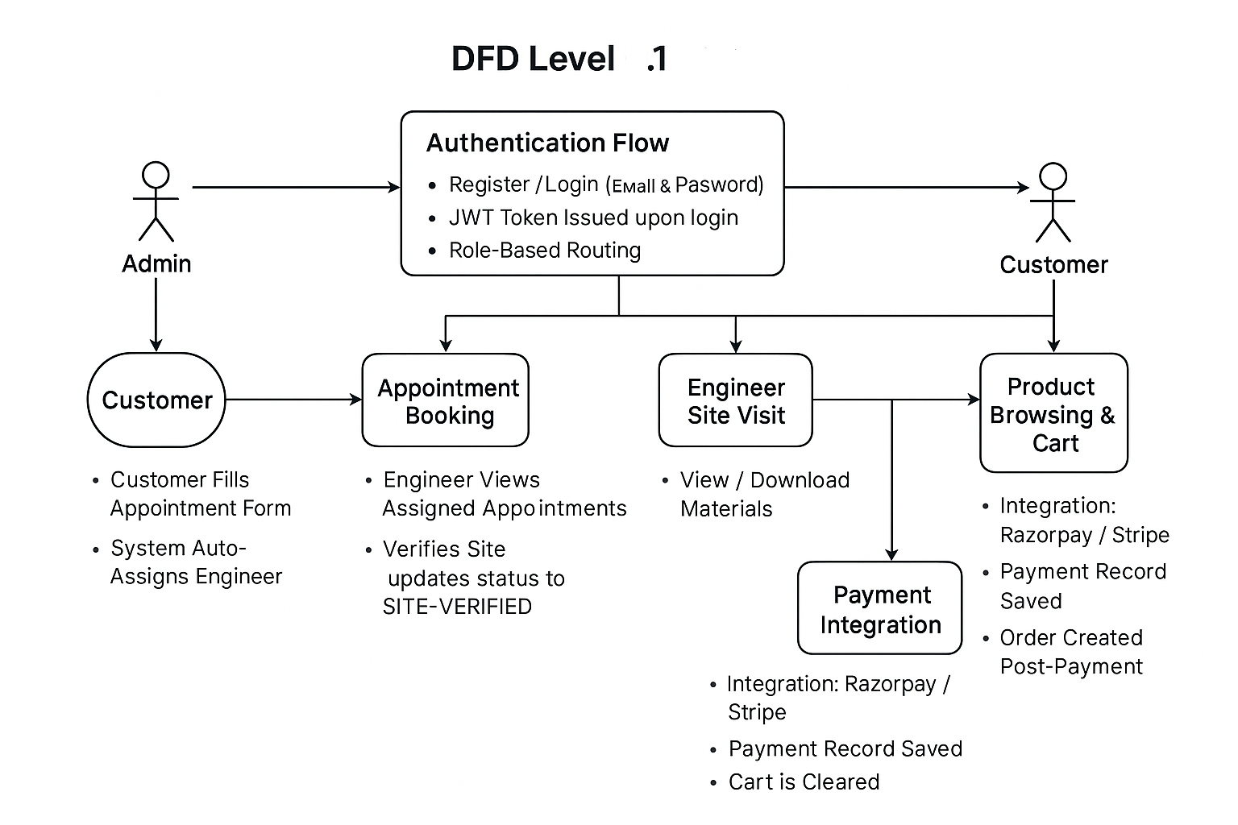
Data Flow Diagram
14.

Slide 15
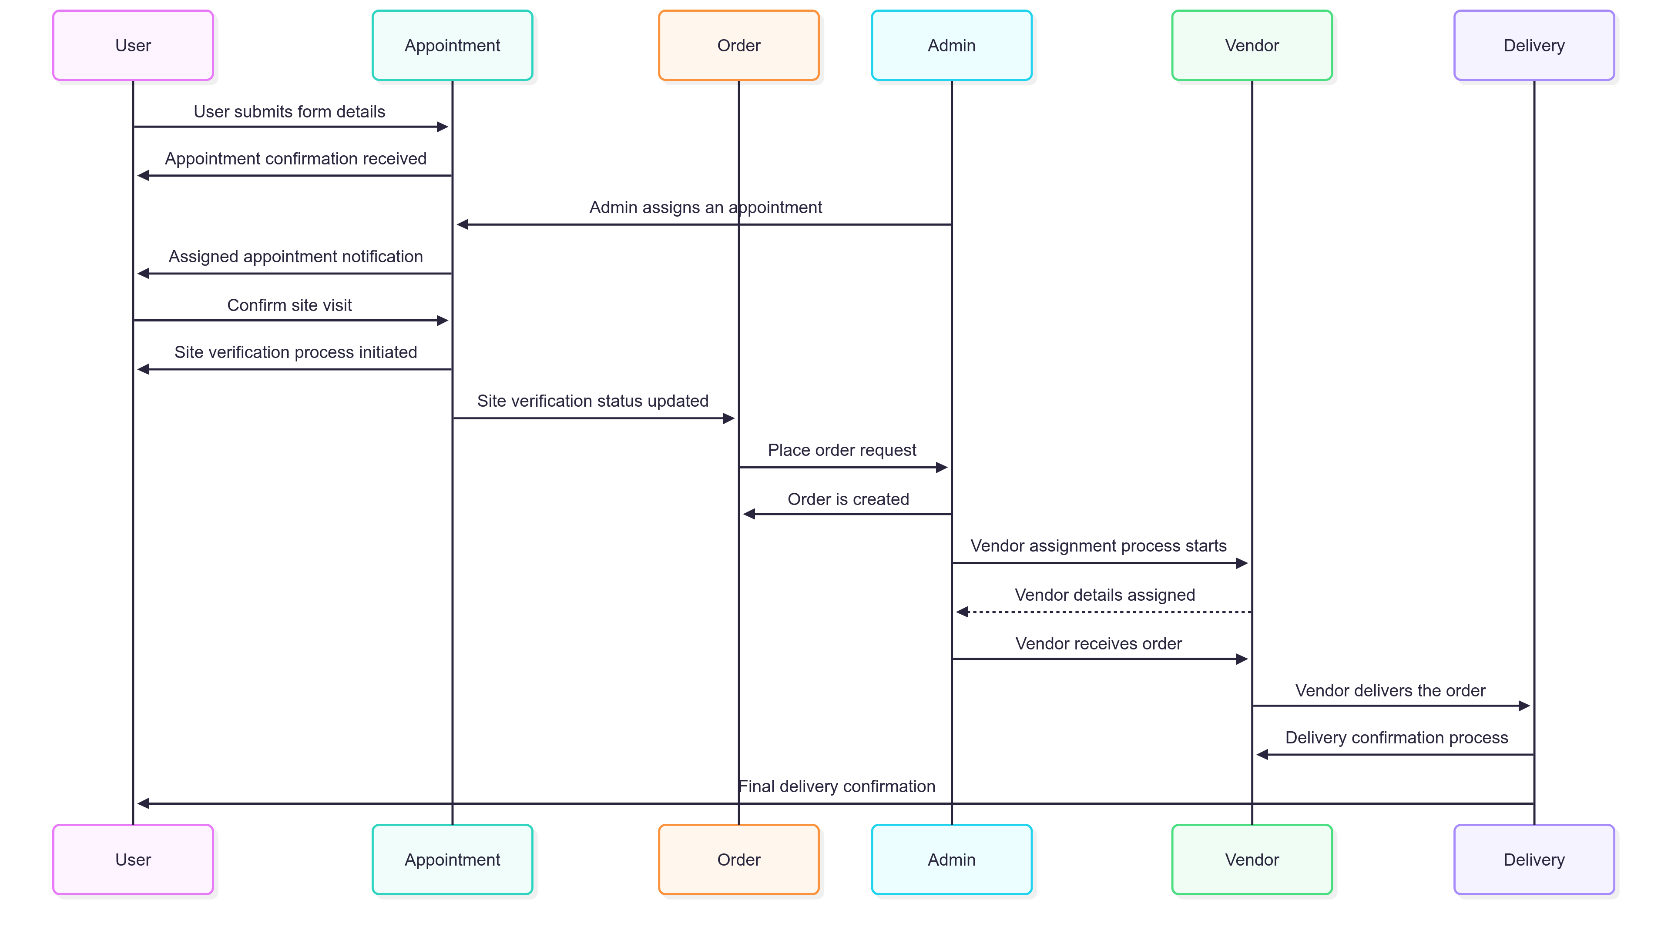
Sequence Diagram
15.

Slide 16


